Slide 1

Magna Inácio Universidade Federal de Minas Gerais (UFMG) The Politics of Unilateral Decisions in Presidential Systems: Administrative Decrees in Comparative Perspective Symposium “Populism, Political Crises, and Impeachments in Latin America Center for Latin American Studies – Stanford University May 13, 2019
Notes:
This paper addresses the use of unilateral actions ,executed through executive decrees, in Latin American countries and the US. It is an ongoing project about the institutional presidency in comparative perspective.

Slide 2
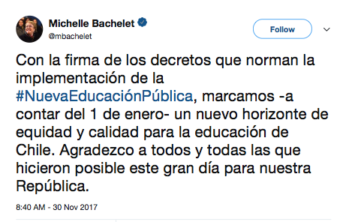
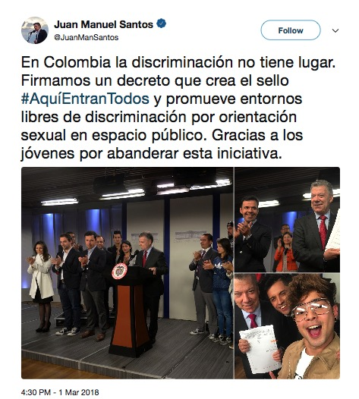
Why are administrative decrees becoming so popular, even for constitutionally powerful presidents?
Notes:
What moved us to analyze these unilateral actions, to undestand the motives behind more and more frequent facebook posts, tweets from presidents claiming credit for their administrative decrees, like:
The latest decree of President Bolsonaro, last week, made it easier for Brazilians to buy guns and ammunition with administrative directives “relaxing gun-control laws took effect in Brazil on Wednesday, boosting access to foreign-made firearms and ammunition, raising limits on how much ammunition a gun owner can purchase, and letting gun enthusiasts carry loaded weapons to shooting clubs.”
Bachelet, from Chile, announced a profound change in the education policy, initially motivated by administrative decrees.
Finally, President Santos declared, with activists, new steps inhis policies against sexual discrimination.
WHY IS IT SURPRISING? BECAUSE SOME OF THESE PRESIDENTS HAVE STRONG LEGISLATIVE POWERS TO APPROVE LAWS ON THIS POLICIES BUT, NEVERTHELESS, DECIDED TO IMPLEMENT THEM THROUGH DECREES.
SO, OUR AIM IS TO UNDERSTAND, IN A COMPARATIVE PERSPECTIVE, WHY AND TO WHAT EXTENT PRESIDENTS RESORT TO ADMINISTRATIVE DECREES TO IMPLEMENT THEIR PREFERRED POLICIES.
Comments (already reviewed):
Decrees issued by president Dilma authorized sectoral expenditures that were not foreseen in the annual budgetary law when it was approved. This kind of budgetary adjustment is regulated by laws and, in some situations, a legislative decision is needed. The violation of these laws may lead to the conviction of the incumbent for common crimes or for the crime of responsibility. President Temer is under investigation for the Decree nº 9.048, May 10, 2017, known as the “decree of the Santos Port” because it regulates the port’s country. Investigators allege that president Temer accepted bribes in exchange for extending the concessions in the port of Santos for a company.

Slide 3
What can we learn from comparing unilateral actions across presidential systems?
Exploring the incentives for decree issuance by presidents
US
The ambiguity of the US Constitution on executive powers as a factor that boosts unilateral administrative actions of the presidents.
LA countries:
the wide array of legislative powers allows president to engage directly in the law-making process, making administrative action less valuable for advancing presidents’ policy goals;
they may be politically weak (minority presidents and fragmented congresses);
Coalitions, as a solution to form a political majority, may be an additional source of weakness: cabinet politics also matter!
Notes:
How can a comparative analysis help us to better understand the frequency of Presidential decrees?
_ In the US, the literature has considered the constitutional weakness of executive power as an incentive to the issuing of executive orders by the president.
Conversely, the scholarship on presidentialism in LA countries points out the strong legislative powers of the presidents and, in the same way, assumes that these are more strategic for the presidents. This literature has paid little attention to the use of executive directives for implementing law, administrative decisions or personnel regulation, as tools to advance presidents’ policy goals, even though they are potentially of low cost.
In this paper, we explore the variation of incentives behind the issuing of decrees.
Hence, not only conflicts between congress and the executive matter, for understanding presidential discretion to use administrative powers, but also those resulting from cabinet politics adopted by the president. If it is true, we should travel beyond the US to test this hypothesis.

Slide 4
What can administrative decrees reveal about presidential discretion in managing inter-branch and cabinet conflicts?
Studies of LA presidents’ unilateral actions focus mostly on their decree powers, given their strong potential to change the status quo of policies successfully, and the agenda-setting powers that enable presidents do avoid legislative overturn.
Hence, little attention has been paid to the use of executive directives as tools to advance LA presidents’ policy goals, even though they are potentially of low cost.
This view has been challenged by studies showing that presidents, even powerful ones, resort to administrative tools to cope with inter-branch divisiveness and cabinet politics through:
political nominations and agency design,
the redesign of the presidency, and
distributive politics.
Notes:
Presidential discretion in law-making is defined by a wide array of legislative powers vested in the presidents in LA countries. These include the power to initiate legislation, including constitutional amends, exclusive power to initiate budgetary bills and, mainly, the power to issue decrees having the force of law. This decree authority is vested in the presidents by the Constitution or legislative delegation, and they are associated with the legislative success of the presidents in LA countries.
Given these legislative powers, scholars have being paying less attention to the use of administrative decrees. Only recently, some studies have shown their use for the management of the cabinet and bureaucracies, to implement presidential distributed politics, and to redesign the presidency. In the first part of this project, Mariana Llanos and I have demonstrated that the expansion of the institutional presidency is greater under coalition government.
********
Constitutional executive authority includes decrees issued by the president without previous legislative approval in emergency situations, demanding exceptional measures, such as urgent actions or suspension of rights.
Delegated executive authority requires a legislature’s pre-approval, authorizing the president to issue executive decrees having the force of law. This authorization usually determines the length and scope of this delegated power.

Slide 5
Research Questions
Why does the amount of decrees issued by presidents vary considerably across separation-of-power systems?
Beyond the legislative powers of the president and interbranch conflicts, does the type of cabinet matter for explaining fluctuations in this amount?
Notes:
Hence, the relevant question is not whether presidents vested with broad legislative powers will or will not resort to the use of administrative powers to pursue their policy goals, but under what conditions they will do so.
In order to contribute to the broader picture of presidential discretion across presidential systems, our research questions, in this initial phase of this analysis, seek to capture the variation in the use of decrees by presidents and the factors that might explain this variation.
*********
FIRST, in Latin American democracies, presidents are very, if not the most, powerful political actors. They control a wide array of powers such as the constitutional resources of vetoes and decrees, the unilateral organization of the executive branch, and political nominations.
SECOND, the party composition of the governments differs alongside the countries. With the increasing fragmentation of the party systems, some Latin American presidents have strategically built coalitions and multi-party cabinets in order to achieve legislative majorities.

Slide 6
Key Arguments
We argue that unilateral actions vary due to:
the weakness or strength of the constitutional legislative powers of the president,
the partisan powers of the president.
However, we disentangle the president's partisan powers, adding a new dimension:
intra-cabinet conflicts: coalition is a strategy for the president to overcome a minority condition, however
the ways that presidents build legislative and cabinet coalitions may generate different political constraints.
Notes:
We follow the scholarship on unilateral politics, exploring the consequences of the weakness or strength of the constitutional and partisan powers of the president.
However, we disentangle presidents’ partisan powers in two directions: inter-branch and intra-cabinet conflicts. Cabinet conflicts are the variable of main interest in our analysis, because it is a source of presidential weakness that is less considered by LA scholarship on presidentialism. Intra-cabinet conflicts can put pressure on the president, politically and administratively, to use more decrees for the horizontal coordination of departments, centralization of decisions, and control of ministers and bureaucracies under their command.
We argue that presidents are motived to act unilaterally not only to get around hostile legislatures, but also deal with pressure from cabinet parties and keep tabs on cabinet members and bureaucracies.

Slide 7
Counting Presidential Administrative decrees
What we count
What we do not count
Implementing laws
Administrative directives
Personnel regulation
Symbolic or ceremonial promulgation of international agreements
Nominal appointments
Nominal concessions of utility services
Notes:
What do we count as an administrative decree? As I mentioned before, it doesn’t include decrees having the force of law: administrative decrees are issued after a legislative decision or as an autonomous administrative decision.
To implement this model, we classify all decrees and, after, count as administrative decree only those classified as:
1-Decrees for implementing laws define conditions and give instructions for the proper execution of laws.
2-Administrative Directives comprise all decrees used to (re)design the structure and function of the executive branch to create or modify executive agencies, intradepartmental units, and advisory commissions; to allocate and transfer budgetary resources; to drive bureaucracies’ actions. 70% of the total of decrees in our subset.
3-Regulation of civil service and political nominations. These decrees regulate changes to the rules related to: the grade and pay structures of the civil service; personnel recruitment, nomination and relocation; and, career progression and concessions of benefits (pensions, travel grants, licenses) for civil servants and nominees.
What we exclude from our counting:
decrees that are symbolic (declaration of the public interest status of social organizations) or ceremonial (awards; naming buildings; declaring days of commemoration or national mourning; holidays, etc.);
decrees that ratify or promulgate international agreements and treaties, if they do not explicitly include provisions or instructions for domestic polices;
decrees that nominally appoint, dismiss, authorize retirement, provide pensions or impose disciplinary measures on executive personnel. Paraguay (almost 12,000 decrees), Colombia (almost 3,000 decrees) and Chile (6,000).
decrees that nominally, for individuals or firms, grant concessions for utility services, or define and reimburse land expropriation for agrarian reform or public works purposes. In Chile, it represent almost 47,000 decrees.
In the case of the US, we count only Executive decrees and, in other countries of our subset, we consider only decrees signed by presidents (and with ministers when the constitution requires, such as in Argentina, Chile, Peru and Paraguay).

Slide 8
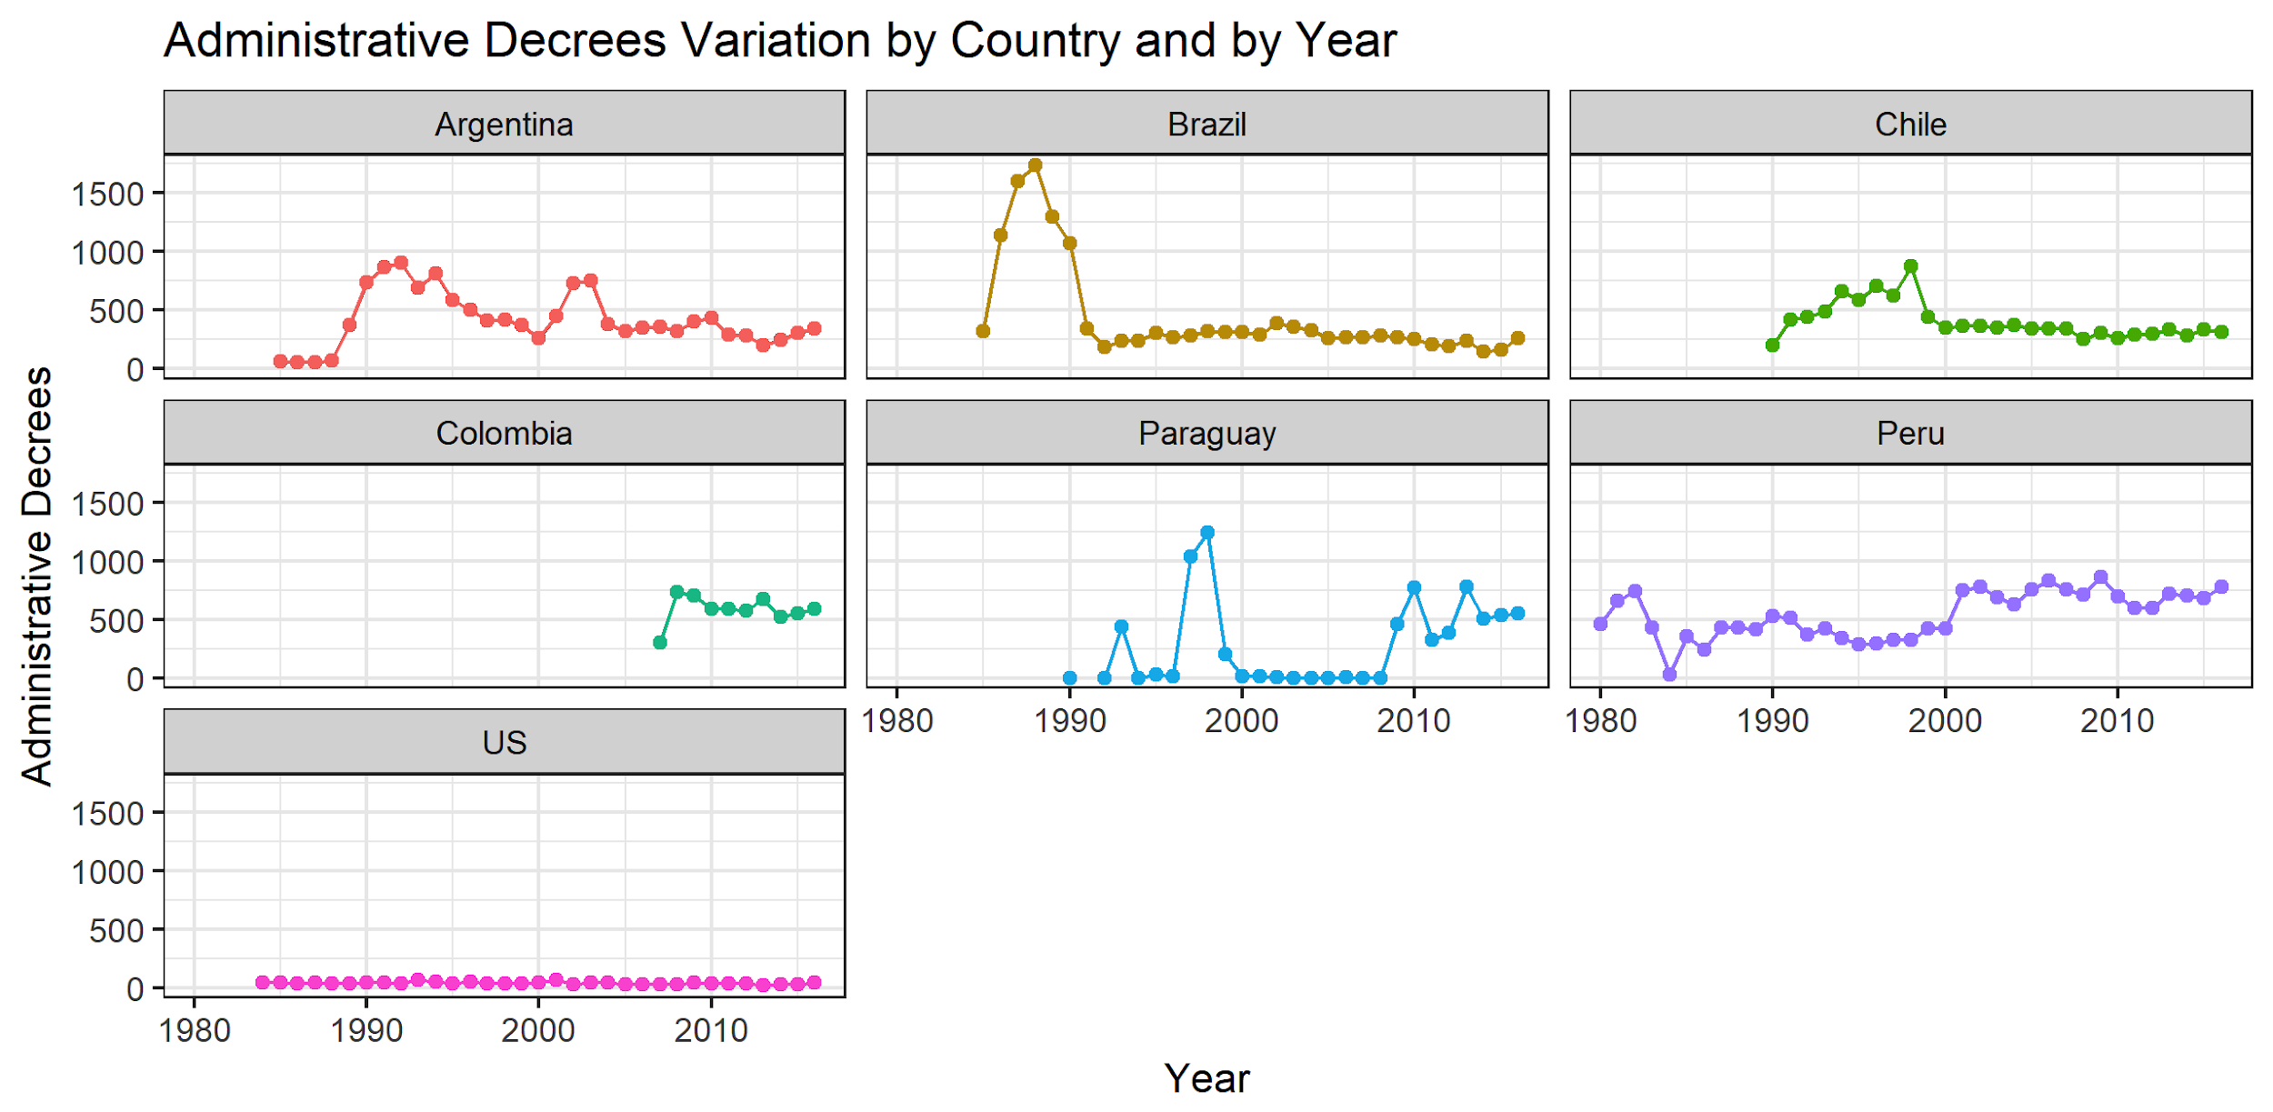
Administrative Decrees by Country and Year, 1984-2016.
Notes:
In this figure, we can observe the variation of the annual number of Presidential decrees by country and year.
The original dataset contained 250,000 (two hundread fifty thousand) decrees, but after this classification our final total was around 73,000 (seventy three thousand) decrees. Then, we count the annual number of issued decrees as our dependent variable.
The most impressive oscillation in this number is illustrated by the Brazilian case. The Brazilian president Sarney used this tool extensively in 1988, issuing 1,736 decrees, the highest number of annual decrees in our sample. However, it is related to the creation of a new type of decree (non-numbered, without legal effect).
.
Presidential decrees in Argentina, Paraguay, and Chile tend to peak in critical moments of their administrations, but in different contexts.
The US presents the lowest number of presidential unilateral actions, in comparison with the LA countries, except for a few years in Paraguay. On average, US presidents issued 39.4 decrees annually. As our series begins in 1985,we do not capture the period of peak usage of executive orders, that occurred during the 1930s.

Slide 9
Dimensions/variables |  | Under which conditions do presidents issue more administrative decrees?
Institutional Powers of the president | Legislative powers | The greater the legislative powers of the president.
Partisan powers of the president | Majority | Whether a political majority backs the president.
Intra-cabinet Divisiness | No. of cabinet parties | The greater the number of cabinet parties.
 | Legislative powers * Partcab | Legislative powers of the president and number of cabinet members.
 | Allies’ Seats | The more dependent the president is on the allies’ seat share, the fewer the number of administrative decrees.
 | EOP size | Larger is the EOP.
Control variables | Presidential Change | A new presidential party.
 | Contextual variables | Low public approval. High inflation ratings.
Notes:
We propose 3 dimensions, referring to institutional and partisan constraints, in order to understand these variations or why some presidents issue decrees more frequently:
First and second dimensions refer to conventional aspects associated with unilateral Politics:
1 – INSTITUTIONAL: includes the formal powers of the president to participate in the legislative process (veto and agenda powers: NEGRETO INDEX: The normalized scores range from 1 to 100. The mean score is 61.8. The lowest score is held by the US (27.3), while Brazil obtained the highest score (100) until 1988, falling to 84.2 after the promulgation of the current Constitution.
2 - PARTISAN POWER: the majoritiy or minority status of the government: In our model, we follow arguments claiming that presidents only refrain from the use of decrees if the Congress is willing and able to overturn their decisions and limit their discretion in policy-making. Additionally, we argue that politically strong presidents might be inclined to issue more regulatory or administrative decrees. Legislative delegation of power to the president increases the majority’s expectations about its returns.
3 – INTRACABINET CONFLICTS: related to the type of cabinet, single or coalition, but we use an indicator of the fragmentation of the cabinet or how many parties control ministerial positions.
Allies´ seats= the president’s dependence on the seats of other parties forming the government (cabinet members)= the percent of legislative seats controlled by the other parties, among the total of all seats held by the government.
EOP: Large presidencies boost the president’s capacity to implement administrative decisions.
Our model includes three control variables such as presidential turnover, Presidential approval and inflation rates
**********
Cabinet Fragmentation: more fragmented coalition implies more transactional costs and risks for the presidential leadership than a single-party or more compact cabinet. The main implication is the that a coaliton government will be associated with a large IP. Here we are using the number of parties in the coalition.

Slide 10
Data
Dependent variable: annual number of Presidential administrative decrees
Period: 1984 – 2016
Panel: country-year: Argentina; Brazil; Chile; Colombia; Paraguay; Peru; USA
Methods: fixed effect linear regression models
Notes:
Let’s move our empirical analysis now. Our dataset comprises 198 country-year records of the numbers of administrative decrees issued by presidents in seven countries:
The data is organized in a panel. We estimated 4 fixed effects linear regression model, but there is no major difference in the results if we apply random effects (where our dependent variable is a count of organizational units).
We estimated four fixed effects models to estimate the effect our explanatory variables.

Slide 11
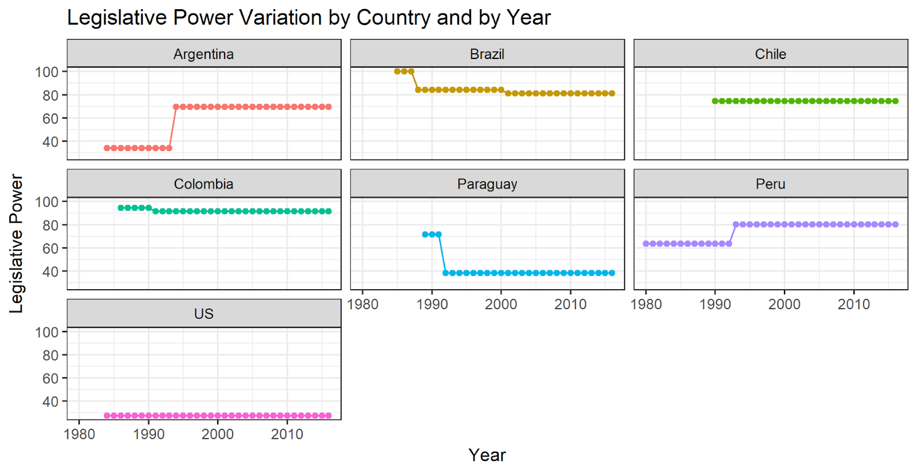
Legislative Powers Index: variation by country and year
Notes:
Before we move to the regression models, let’s consider the oscillations of a few independent variables.
We use Negretto’s index of the legislative power of the president to capture the presidential discretion in law-making. This index variable was generated from a principal component analysis, based on several variables measuring the agenda-setting and constitutional legislative powers vested in the president of each country. The normalized scores range from 1 to 100. The mean score is 61.8. The lowest score is held by the US (27.3), while Brazil obtained the highest score (100) until 1988, falling to 84.2 after the promulgation of the current Constitution.
Here this figure depicts the variation of the legislative power index, in which the oscillations capture changes of agenda-setting powers of the president. We can see great changes in some countries such as Argentina and Paraguay, more incremental changes as in Brazil, Colombia and Peru. In the US and Chile, no changes during this period affected the president's legislative powers.

Slide 12
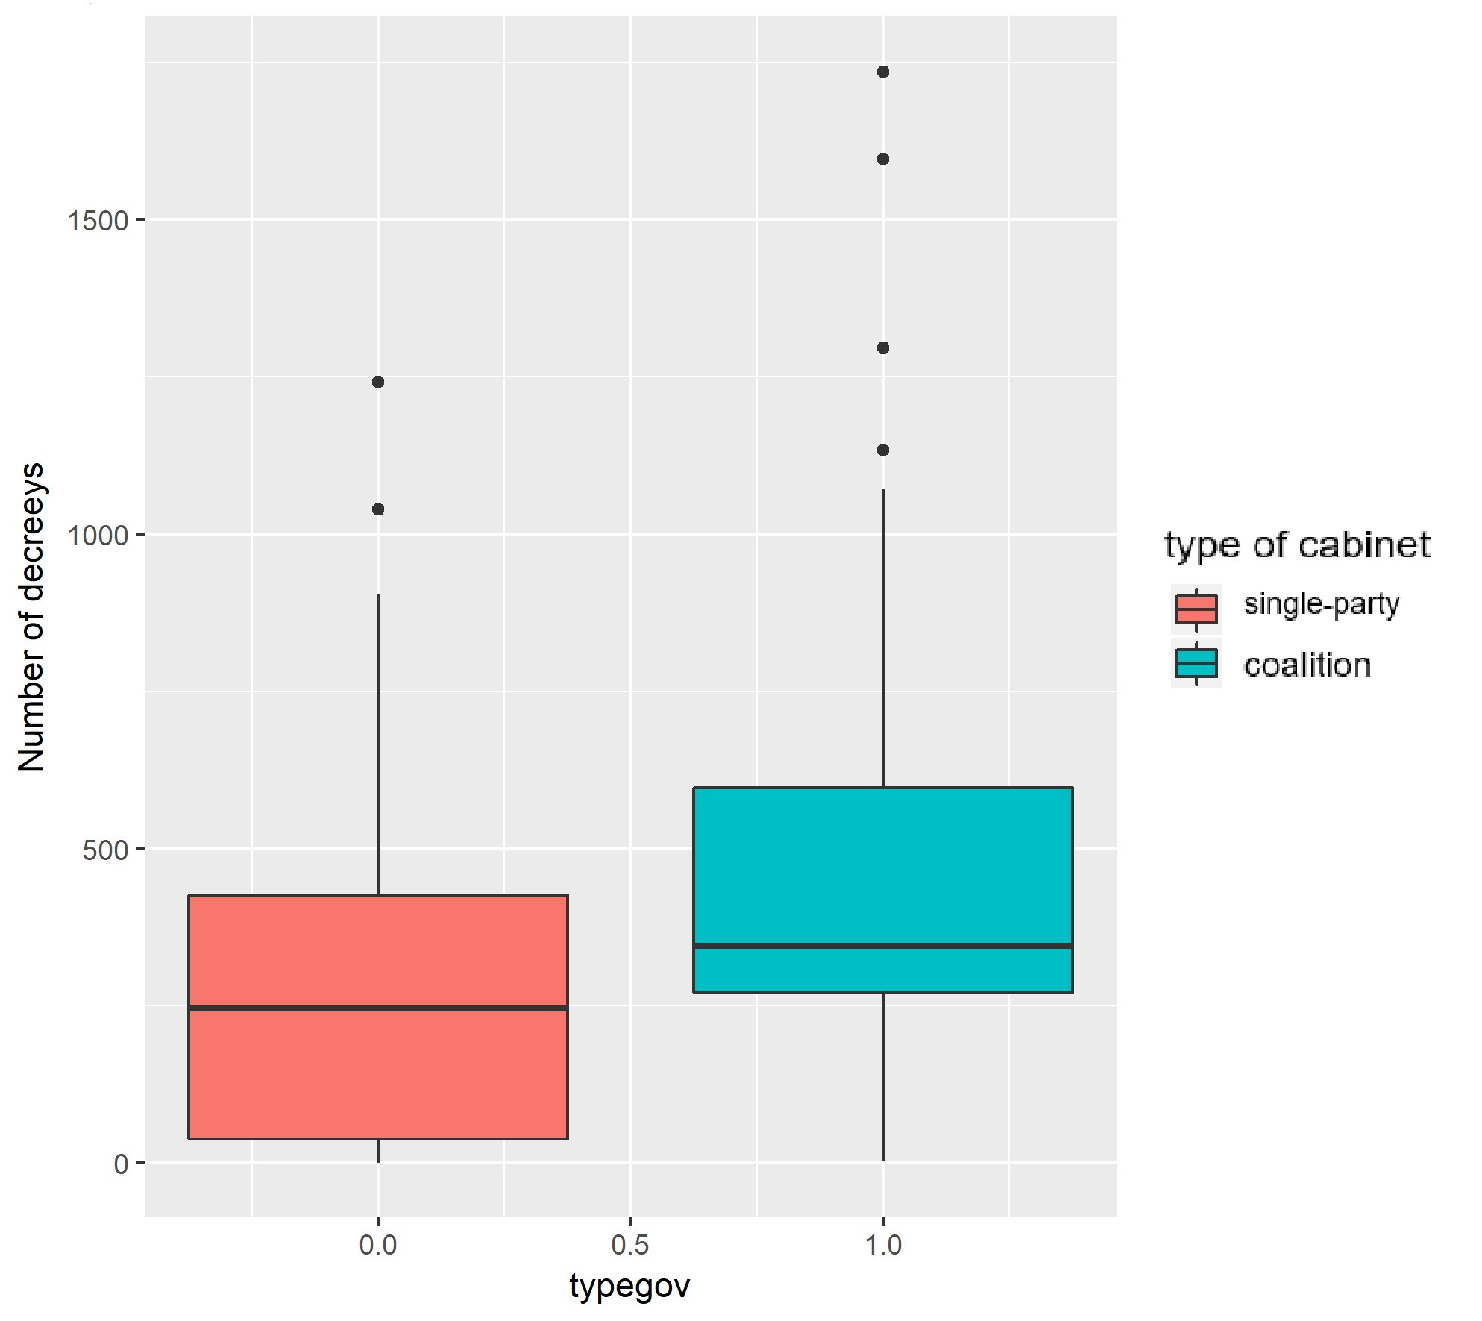
Decrees by Type of Cabinet
On average, presidents leading coalition governments issue more decrees than those in single-party cabinets.
Notes:
The dispersion of the numbers of decrees seems to support our hypothesis that the type of cabinet matters: while coalition governments issue, on average, 455 decrees per year, presidents in single-party cabinet issue only 282 decrees.
However, in our analysis, we measure intracabinet divisiveness by the number of parties in the cabinet.
Single-party=282 annual decrees
Coalition= 455 annual decrees

Slide 13
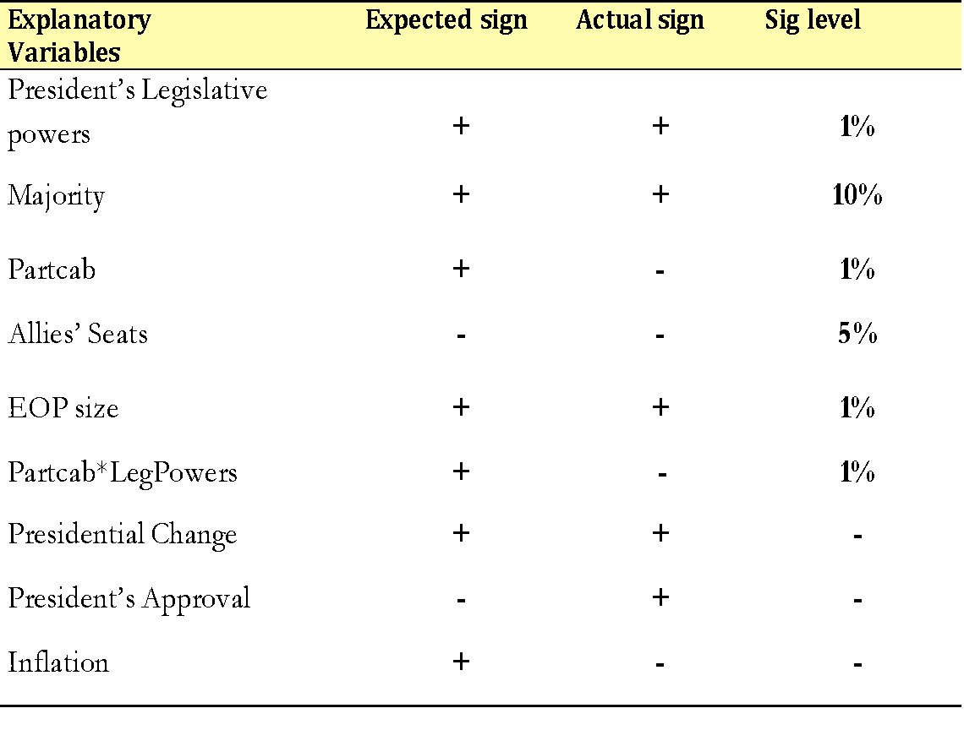
Notes:
THIS TABLE SUMMARIZES OUR FINDINGS FOR THE FULL MODEL, WHERE WE INCOPORATED ALL VARIABLES AND CONTROLS.
The models fit the data quite well, giving support for almost all hypotheses. The unique intriguing result is the unexpected declining effect of our main variable of interest, measuring intra-cabinet divisiveness.
WHAT DO OUR FINDINGS SHOW?
LEGPOWER: The increase of 1 point in this scale increases 11 decrees. It confirms that not only do those presidents having weak or vague constitutional provision of executive powers resort to unilateral actions, but also those holding a richer executive toolbox. THEN, powerful presidents value administrative decrees even when they hold large legislative agenda power.
MAJORITY STATUS: presidents who are backed by a political majority issue, on average, 91.6 decrees more than minority presidents.
HOWEVER, before we conclude that strong legislative powers and majorities lead to more intense use of unilateral actions, let’s consider if cabinet variables temper this trend:
Our main variable of interest, the number of cabinet parties, had an unexpected effect: instead of increasing, it reduced the number of decrees issued by the presidents when coalitions are more fragmented. We estimate this effect through an interaction term of these variables.
Our control variables, which refer to oscillations in presidents’ approval ratings and inflation rates, perform in an inverse direction to what we expected and, also, do not have statistical significance.

Slide 14
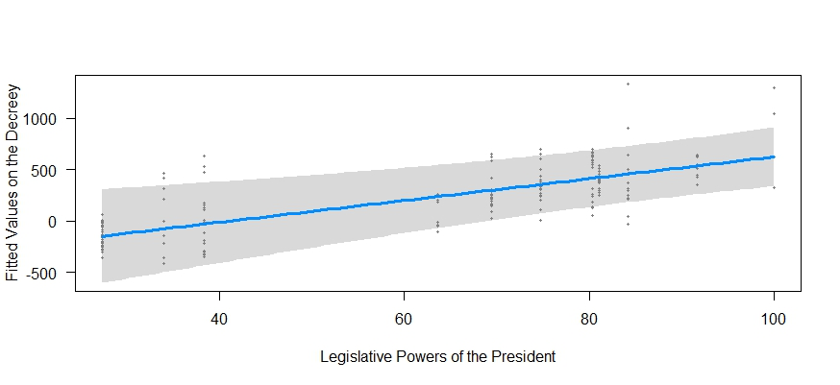
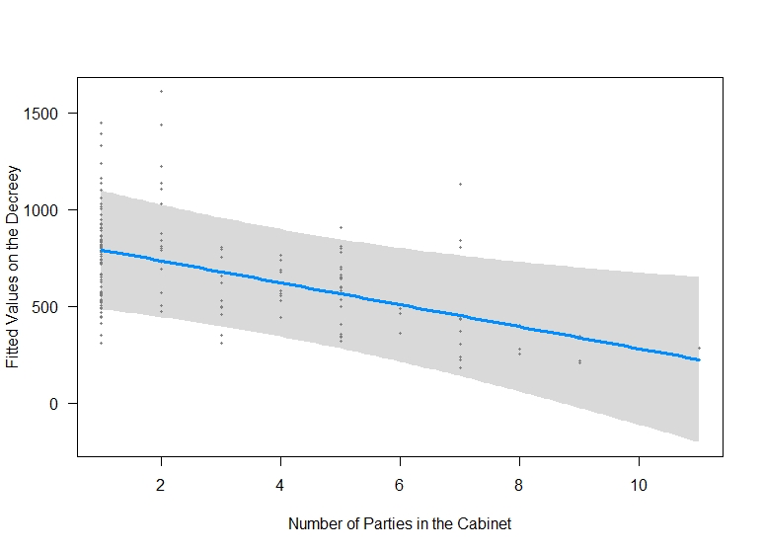
Legislative powers of the president tend to increase the number of decrees issued (as expected), and more fragmented cabinets seem to inhibit these presidential unilateral actions (not expected!).
Notes:
Here, these graphs display the effect of two of our main variables of interest:
Legpower, as expected, tends to increase the number of decrees: presidents who are backed by a political majority issue, on average, 91.6 decrees more than minority presidents.
However, this strong unilateralism in powerful and majoritarian presidential systems are tempered by those factors related to the type of cabinet, bringing substantive implications to the comparative study of decree issuance by presidents. This picture shows us the negative effect of the number of cabinet parties.

Slide 15
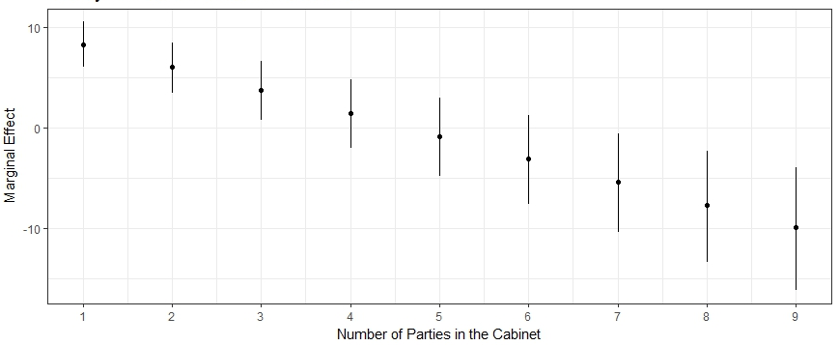
Marginal Effects of Legislative Powers of the President on Decree by Number of Parties
In more fragmented coalitions (4 or more parties), the association between legislative power and the number of decrees becomes negative.
Notes:
Lets take a look at the marginal effects of the interaction between legislative powers and the number of parties variables.
As we can see, when the number of parties in the cabinet is relatively small, the legislative power is positively associated with the number of decrees (1-3). However, in more fragmented coalitions (more than 5 parties), the association between legislative power and the number of decrees becomes negative.

Slide 16
Unpacking the Administrative Decrees as Multi-targeting Tools
Understanding the scope of these decrees and their strategic value for avoiding inter-branch and cabinet conflicts requires distinguishing the different types of presidential moves they make viable.
We are using machine coded topics (STM) to identify in which administrative decree(s) lies the presidential attention.

Slide 17
To what extent do presidents resort to administrative decrees?
Illustrating with Brazilian case:
Notes:
We saw in the previous analysis how constitutional and political constraints affect the number of decrees issued by presidents. Now, look at a specific case, the Brazilian case, to reinforce variations across presidents and policy decision areas.
This graph shows us the total number of decrees issued by all Brazilian presidents elected directly after the military dictatorship. Only Cardoso and Lula who, by now, both have completed their mandates and been reelected, so they were in power longer than Collor and Dilma, removed by impeachment; Itamar and Temer, vice-presidents that assumed the power after the impeachments; and Bolsonaro, whose mandate started this year (2019).
We can see considerable difference in the number of decrees issued.

Slide 18
What are presidents targeting by issuing administrative decrees?
Notes:
This is an initial attempt to distinguish the sort of decisions that are issued by administrative decree that will allow us to explore variations in decree issuances across presidents and countries.
By using structural topics modelling (STM), our first findings reveal 5 groups of goals pursued by the presidents. These graphs plot the main words in these decrees associated with each topic.
1) Implementing law: this topic refers to presidential directives defining how each law, either globally or in some parts, should be implemented.
2) Personnel regulation: decrees defining administrative regulation of civil service, and changes in their allocation of the staff across executive units.
3) Budgetary allocations: these decrees transfer budgetary resources among ministries and agencies, a strong instrument for distributive politics.
4) Foreign affairs: decrees implementing treaties, international agreements, etc.
5) Subnational and sector-based allocations: these decrees comprise different decisions benefiting subnational government, communities and sectors (ecological reserve and expropriation for agrarian reform). We can see that “social” is linked to this topic.

Slide 19
What did we learn from comparing unilateral politics across presidential systems?
Presidents having broader discretion, backed by political majorities and large EOPs, tend to resort to larger numbers of decrees.
However,
The effect of greater legislative power is not the same when the presidents bring other parties to the cabinet table.
If majority status is obtained through coalition, and presidents face parties more powerful than their own at this table, they will probably be more prudent about using decrees.
Administrative decrees may be a useful tool for the president to avoid or manage crises when political constraints are taken seriously!
Notes:
READ SLIDE (not review, same of the slides)
Presidents having broader discretion, backed by political majorities and large EOPs, tend to resort to larger numbers of decrees.
However, these trends are tempered by political dynamics that work to restrain unilateral politics:
The effect of greater legislative power is not the same when the presidents bring other parties to the cabinet table.
If majority status is obtained through coalition, and presidents face parties more powerful than their own at this table, they will probably be more prudent about using decrees.
Administrative decrees may be a useful tool for the president to avoid or manage crises when political constraints are taken seriously!

Slide 20
Variations across presidents
(ver notas!)
Notes:
Finally, the variations in the prevalence of the topics across the presidents, revealing difference in the targets of these decrees:
It is important to note that the small proportion of budgetary decisions after Collor derives from the use of non-numbered decrees to implement them.
It is interesting to see how the prevalence of personnel regulation during the short period of Temer and the first months of Bolsonaro government: two administration pursuing reforms of civil service and in the state structures.
Then, this initial analysis of decree contends reveals really interesting differences across presidents, reinforcing our point that political conditions temper the unilateral politics

Slide 21
Thank you!
inacio@Stanford.edu
magna.inacio@gmail.com
Notes:
QUESTIONS:

Slide 22
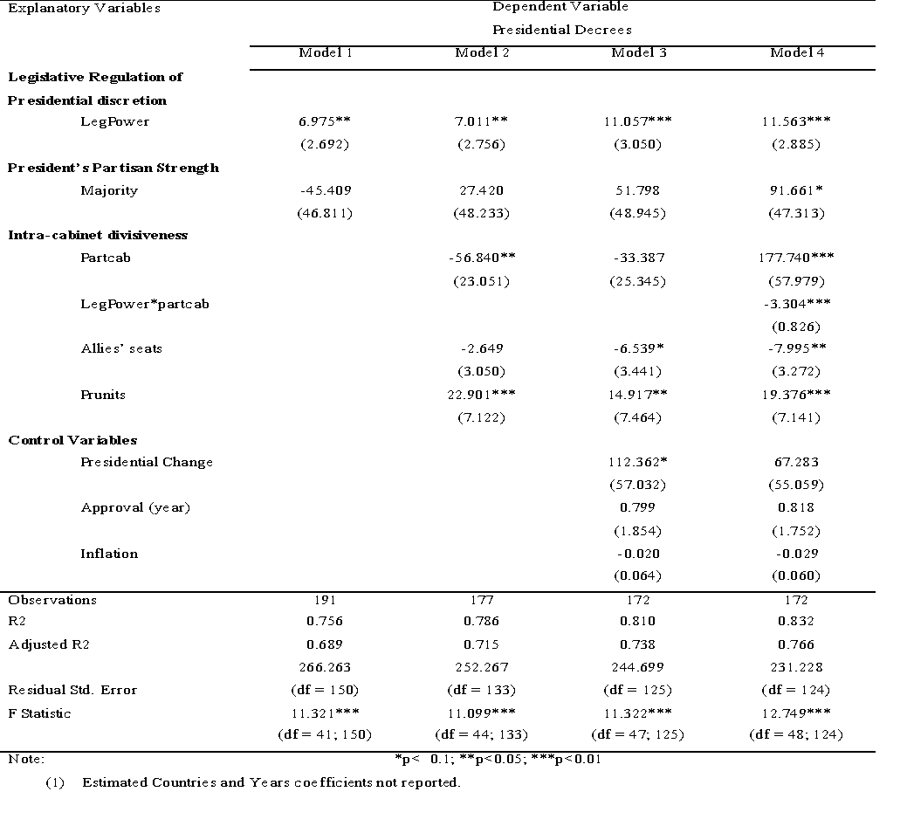
Linear Fixed Effects Regression

Slide 23
Descriptive statistics
DESCRIPTIVE STATISTICS | AVERAGE | MEDIAN | STANDARD DEVIATION
legpowers | 64,84 | 74,68 | 23,21
partcab | 2,37 | 1,00 | 2,01
seats_other | 16,93 | 5,90 | 20,24
prunits | 9,89 | 9,00 | 4,58
approval_Y | 46,40 | 46,66 | 15,30
inflation(lag) | 137,05 | 7,56 | 590,08
Dummies
Partisan Majority | 0,60
Presidential Change | 0,43
Notes:
Here some descriptive statistics of our explanatory variables, but let move on to our findings.

